Slide 1
Diagnostic Essay Feedback Analysis
Mariana Abuan
Baylynne VanWagenen
March 8th 2017

Slide 2
Purpose
This presentation will provide a case study focused on task analysis with writing. More broadly, we will feature a process of engaging structured input on designing meaningful and effective prompts.

Slide 3
Importance of Task Analysis
Help us establish guidelines for instructional goals and objectives
Understand the types of knowledge that characterize a job or task
Develop instructional activities that foster learning
Pair learning outcomes with the appropriate activity
Learn more about faculty perspective on instructional activities

Slide 4
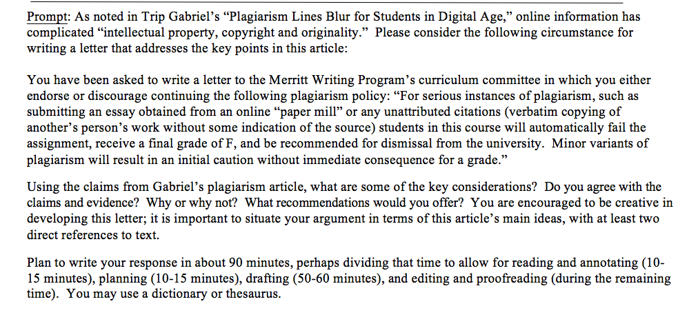
Source Material: The Writing Prompt

Slide 5
Gathering Evidence To Answer Key Questions
“We need to consider the results of the test within the context of its own curriculum and students by gathering evidence to answer key questions:
How is writing represented in the text?
Does it elicit a sample that adequately represents the students’ skills and abilities?
Once the evidence is gathered from the investigation, it must be evaluated to determine if it is an adequate test”
(Source: Naming What We Know, O’Day, p.160)

Slide 6
Method
Assessment practices are a reflection of the values of the instructor, institution, or group behind the assessment.
Assessment Committee sought to understand the extent to which our diagnostic writing prompts were a valid and reliable form of assessment, and one that reflects the values of our field and the teaching practices of our classrooms by designing a Diagnostic Feedback Survey.
Open ended questions to identify a pattern rather than impose a pattern on instructors
Serves students, faculty, and the program
Criteria can be gained through community and collaboration and faculty expertise
Privileges the local community

Slide 7
Diagnostic Feedback Survey
To what extent is the level of difficulty and style of writing in this reading sample similar to reading in WRI 1 / WRI 10?
Are the prompt instructions clear in describing the task and basic expectations?
In what ways does the task adequately represent the skills and tasks commonly practiced in a MWP composition course? Think in specific terms like:
Reading and understanding a prompt/the task
Employing an appropriate tone/language/writing to a specific audience
Developing and organizing a logical response to authentic topics and issues?
Incorporating/synthesizing a source in their own writing
Other:
Which two program learning outcomes are best elicited by this diagnostic prompt? Generally, how so? (Craft, Rhetoric, Research Ethics, Process, Collaboration)

Slide 8
Results: Principles for Creating a Diagnostic Prompt
Understand what will be possible for students to accomplish in the limited time frame.
Identify the purpose of the prompt. Limit the scope of the prompt to reflect the skills/outcomes to be measured.
Clarify students’ main task
The prompt format should be considered and how it highlights and emphasizes the main task.
Match the prompt to what faculty are already doing in their classrooms.
Consider the language of the prompt and how students might understand it.
Language of the prompt should mirror the language of course and program outcomes.
Notes:
Decide what we want to assess for. Our current prompt asks for too many things so we don't get a good measurement of what students can do.

