Slide 1
Developing a Sustainability Communications Laboratory with and for STEM Graduate Students
Anne Zanzucchi, Interim Director for the Merritt Writing Program & Humanities, World Cultures faculty
azanzucchi@ucmerced.edu
Assessment as Research, UC Merced(8 March 2017)

Slide 2
Overview
Motivations for graduate curriculum with sustainability themes
Concepts and desired outcomes of this graduate communication laboratory design

Slide 3
Assessment Stages
Set goals and outcomes
Develop and implement planning
Evaluate results
Create action plan

Slide 4
System-wide Context
UC Office of the President initiated the Carbon Neutrality project
http://www.ucop.edu/initiatives/carbon-neutrality-initiative.html
Project includes the Climate and Sustainability Resource Library with learning materials related to climate change and sustainability.
http://cserl.ucop.edu/

Slide 5
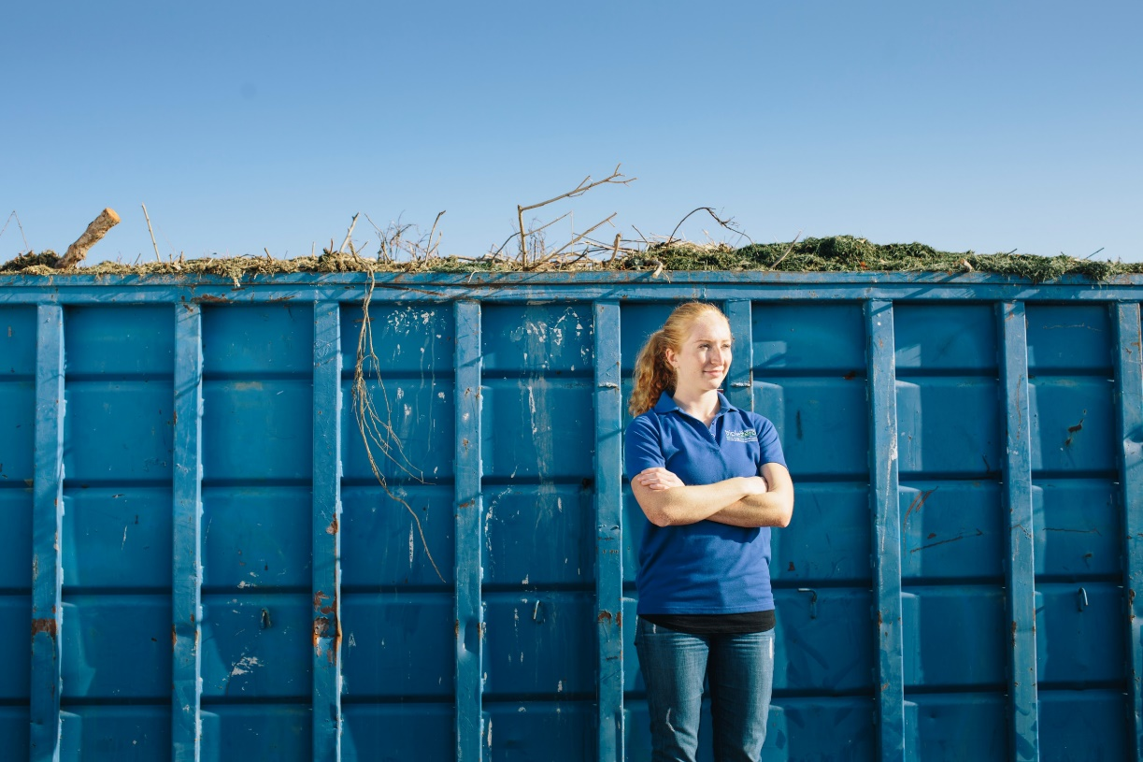
Start with the Beginning
Academic Planning Activities
Cross-disciplinary retreat
Mission statement
Sustainability learning outcomes
*Themes and cross-disciplinary imagination can drive inclusive, comprehensive academic planning*

Slide 6
Set goals and outcomes: Shared Concepts
What is sustainability (in campus teaching and research)?
education
social justice
culture
efficiency
resource management
closed loops
dynamic system
action
This collaborative process for developing criteria is based on Bob Broad’s Organic Writing Assessment: Dynamic Criteria in Action (2009). The open access copy is at http://digitalcommons.usu.edu/usupress_pubs/165/
Sustainability involves informed action, reflecting, and contributing toward dynamic systems.

Slide 7
Set goals and outcomes: What should our students know and be able to do?
1. Know where food, water, and energy come from, and where waste goes.
2. Understand waste streams and means of repurposing or reducing them.
3. Elaborate the cultural and historical dimensions within dynamic (eco)systems.
4. Apply appropriate quantitative and qualitative reasoning to the analysis of complex systems.
5. Engage in research, learning, and service experiences involving sustainable practices.
6. Contribute to creative expression and civic engagement about sustainability (and its limits).
7. Describe drivers, consequences and solutions regarding environmental change from local to global scales.
8. Take ethical action as responsible world citizens.

Slide 8
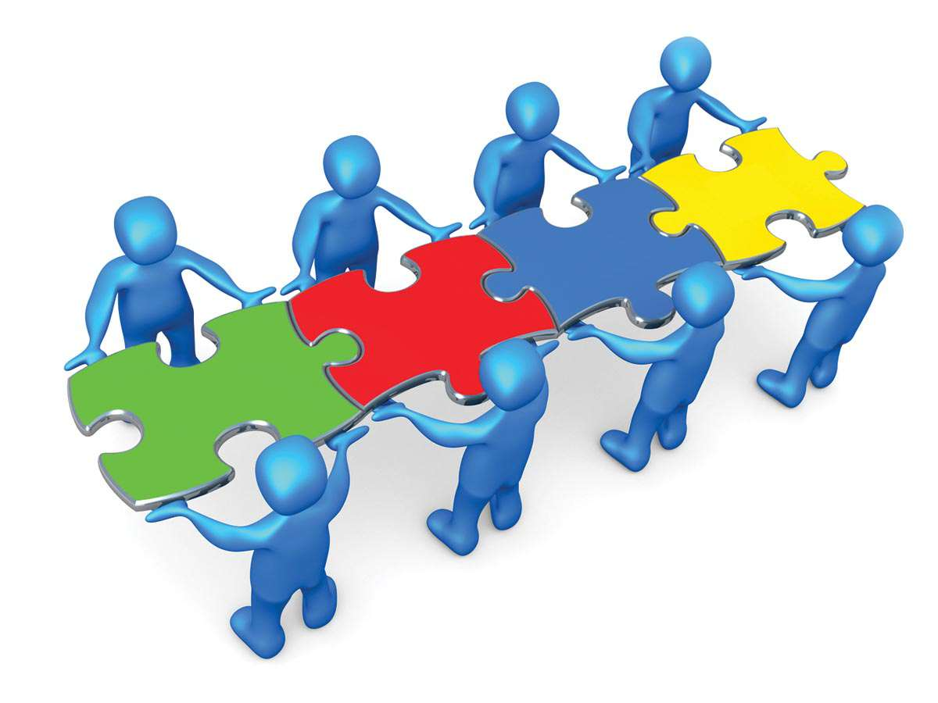
Curriculum Development
Modules include:
Proposing and Marketing Scientific Projects: How are scientific concepts accepted?
Sustainability Research Stories: Identify sustainability themes in our current research
Project(s) development: Create a short genre project suited for social context and topic

Slide 9
Intersections: A Writing Studies Perspective
Sustainability could be viewed as available formats and conventions for expression, with flexibility and constraints¹
High-impact rhetoric is a social activity, with both contemporary and historical resonances
Genres are neither bedrock nor sand

Slide 10
Next Steps
Campus presentations, across disciplines
Climate and Sustainability Resource Library
Outreach to environmental systems faculty on proposed curriculum, as a one-unit blend with current seminars
Special thanks to Lorenzo Booth and
Daniel Toews (Environmental Systems) for their expertise and input on this project

