Slide 1
Aligning Physical Space and Pedagogy to Support Student Learning
Assessing the TEAL Lab
Joan Holmquist - Director, Academic & Emerging Technologies
Anali Makoui & Adriana Signorini – Center for Engaged Teaching and Learning
James Zimmerman - Associate Vice Provost Teaching and Learning

Slide 2
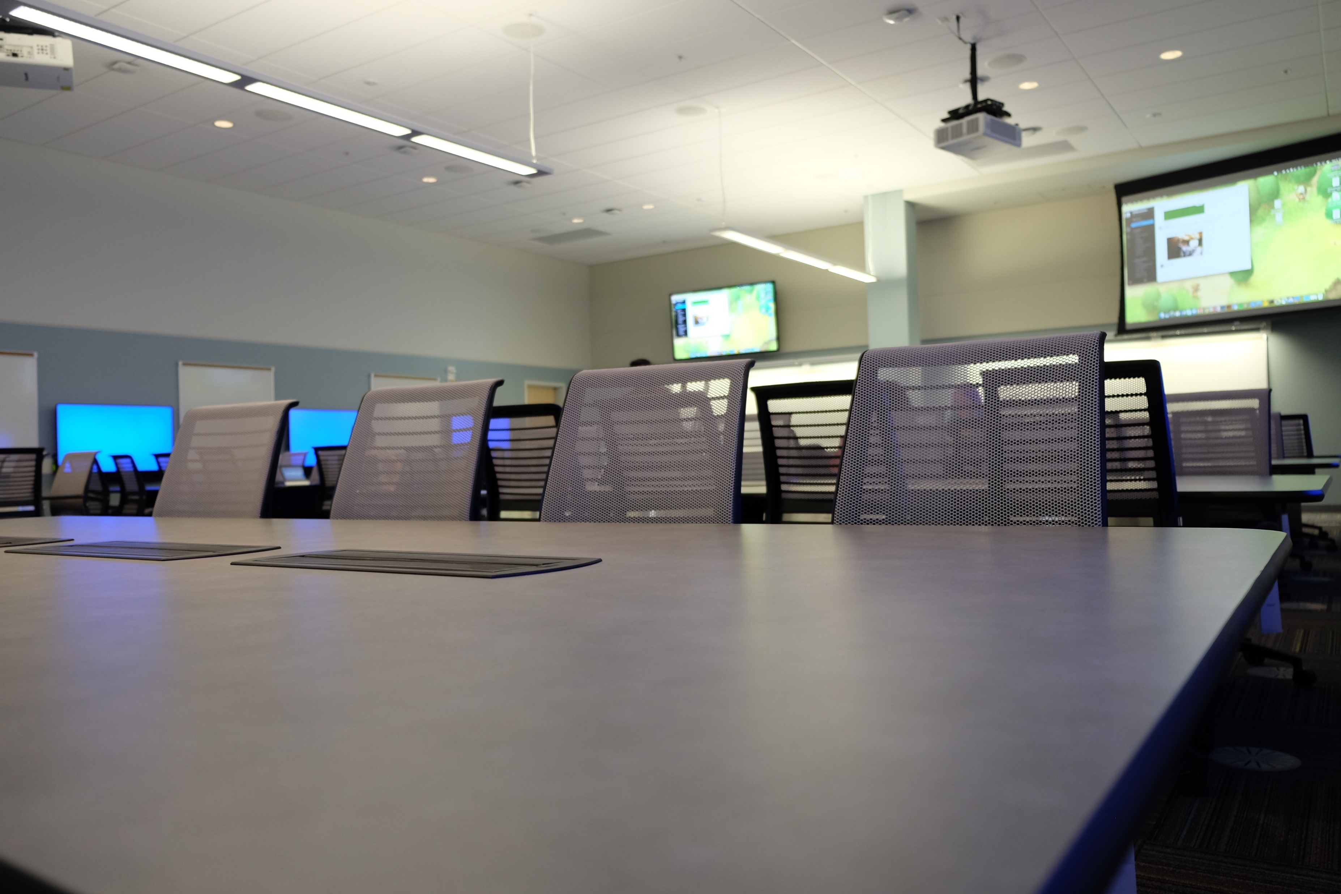
Technology
Enabled
Active
Learning Lab
What is Technology Enabled Active Learning?
Why is it different?
What’s in it for students?
What impact does it have on a course?

Slide 3
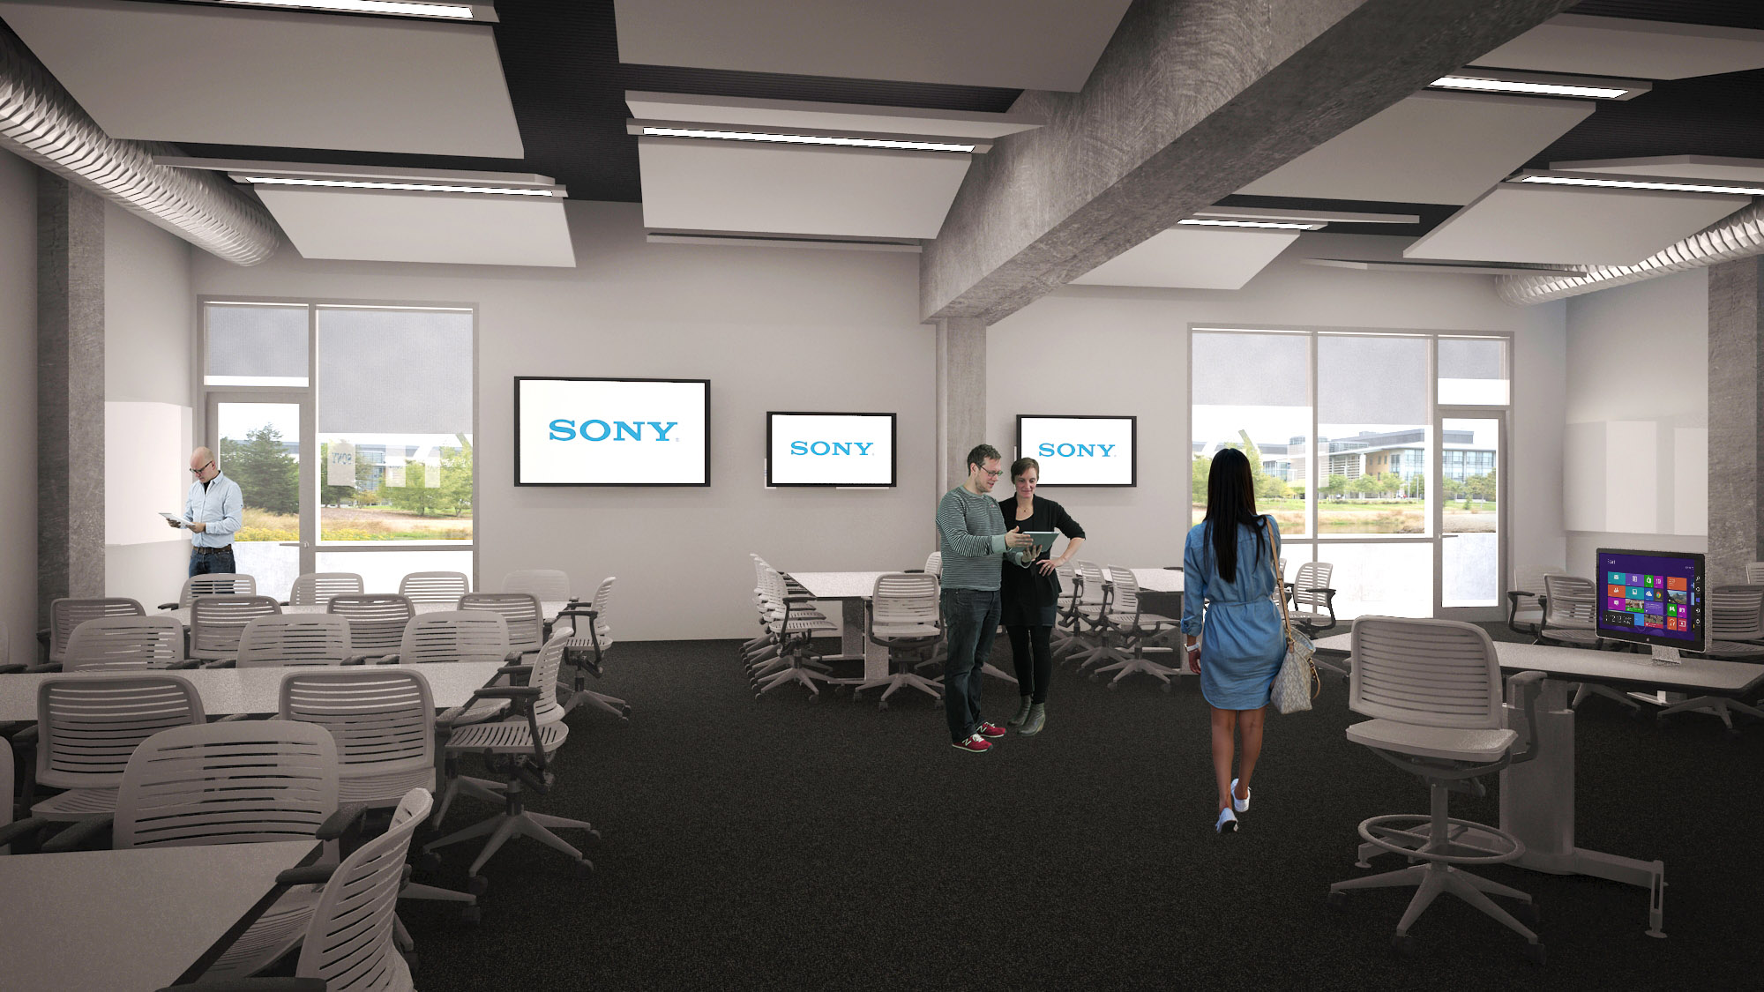
One existing (COB2 Room 175) - 90 seat
Three in UCM 2020 - 90 seat / 45 seat / 45 seat
(complete Fall 2018)

Slide 4
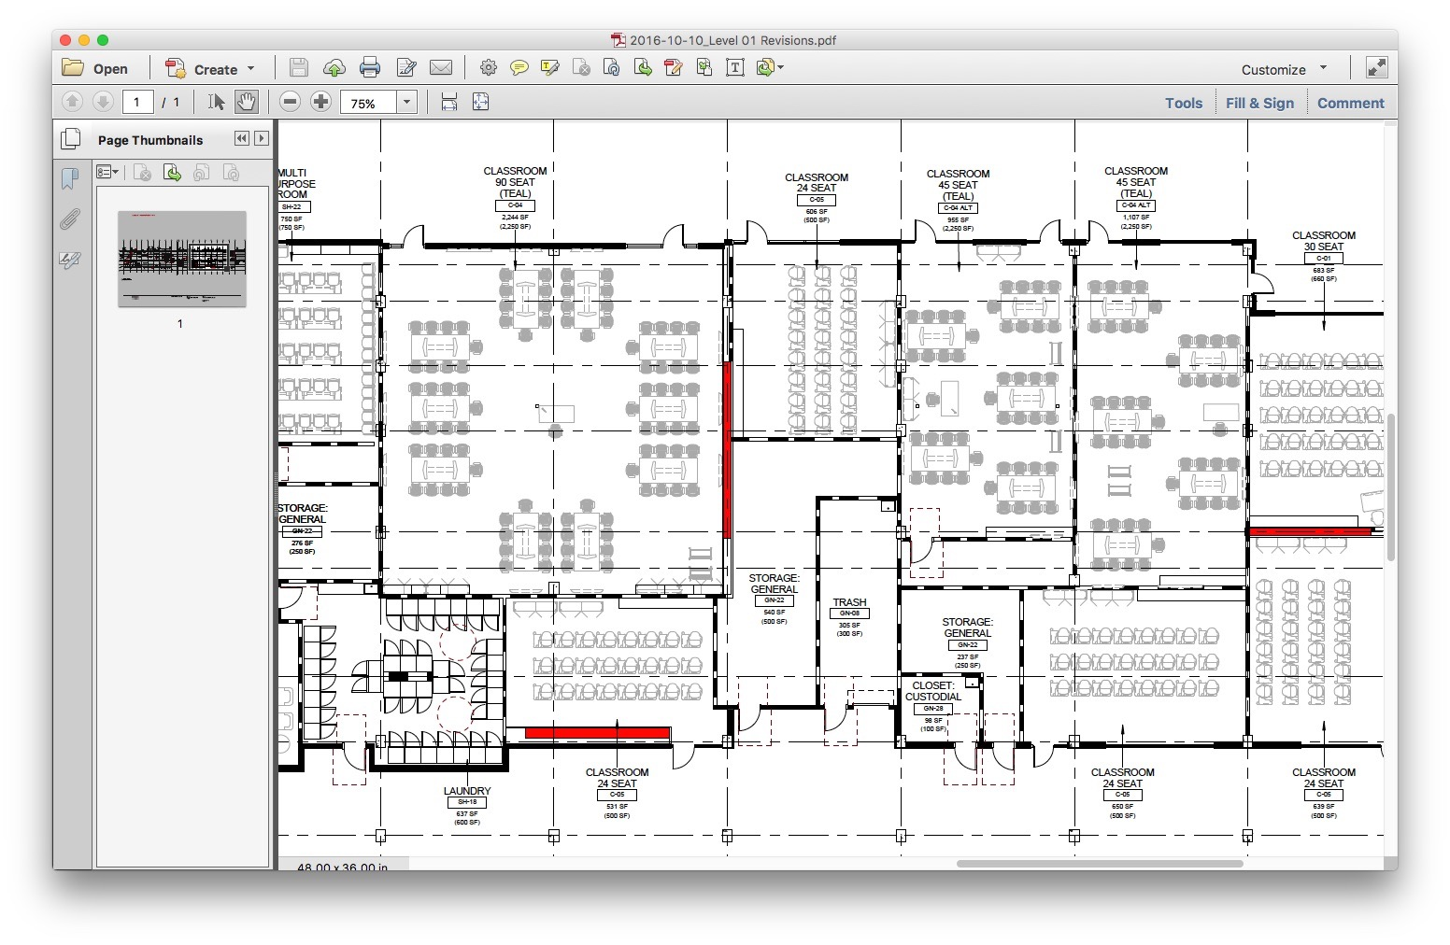

Slide 5
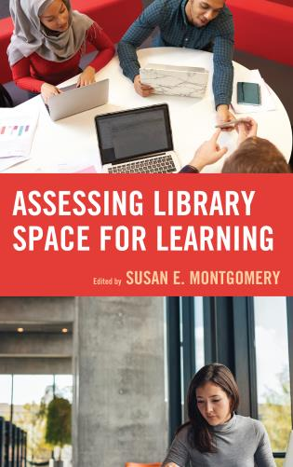
TEAL LAB assessment Research Context
Many campus spaces are designed with intention. Multi-use and specific-use spaces are built to facilitate specific types of interaction and usage (Library, Arts, Science labs).

Slide 6
TEAL LAB assessment Research Context
Students who come from cultures that value and gain strength from community find it difficult to flourish in learning environments where individual achievement is the currency of the realm.

Slide 7
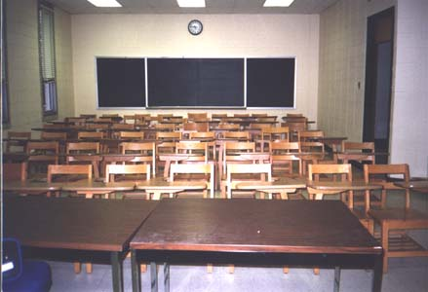
TEAL LAB assessment Research Context
Institutions continue to build learning spaces that discourage the most impactful learning processes for a significant portion of their student population.

Slide 8
TEAL LAB assessment Research question
Does an intentionally designed learning space encourage impactful pedagogies and positively influence student learning?

Slide 9
Student Motivation
Basic Psychological Needs
Student Approach to Learning
Teaching Method / Pedagogy
Physical Learning Space
The TEAL LAB Assessment protocol will collect cognitive domain and affective domain data from students participating in TEAL LAB courses.

Slide 10
TEAL LAB: SPRING 2017 COURSES
Dulai - Bio 002 – Cell Biology
Garcia – Ojeda - Bio 120 – General Microbiology
Singh (3) – 3 NSED courses in Cal Teach program
Yoshimi - Cog Sci 103 – Intro to Neural Networks
Menke – Physics 8 – Intro Physics for Physical Science and Engineering
Mammott - MWP – Writing Program – combined discussion sections designed to facilitate learning communities.
Notes:
Dulai - Nat Sci - Bio 002 – Cell Biology – combined discussion sections allowing for active learning and group work
Garcia – Ojeda Nat Sci – Bio 120 – General Microbiology – active learning following flipped model of instruction and focused group discussions using peer instruction
Singh - Nat Sci – 3 NSED courses in Cal Teach program which introduces students to teaching science and math in K-12, excellent opportunity to show effective teaching methods and learning strategies through inquiry based approach
Yoshimi - SSHA – Cog Sci 103 – Intro to neural networks in cog sci with hands on construction and analysis, using a visually oriented software platform – students will learn neural network modeling and how to use them to model biological and cognitive processes. Great opportunity for group learning using TEAL
Menke – Physics 8 – Intro Physics for Physical Science and Engineering – combined discussion sections focused on collaborative problem solving.
Mammott - MWP – Writing Program – combined discussion sections designed to facilitate learning communities around how humanist and scientist researchers view the world and analyze information.

Slide 11
TEAL LAB: impact on Student learning
Increase class attendance (typically > 90%)
Improve student performance when instructors move to active, student-centered teaching methods
Increase conceptual understanding when compared to lecture/laboratory classes
Reduce failure rates, especially for women, POC, and first-generation students
Notes:
Quantitative - Data gathering and comparison to normative data will be performed by CETL and AET.

Slide 12
TEAL LAB: impact on Student learning
Provide opportunities to strengthen student-faculty relationships
Provide opportunities that strengthen student-to-student relationships, which benefits collaborative project outcomes
Learning environments will be effective for teamwork and collaborative projects
Encourage discussion by helping students feel active and engaged

Slide 13
WORKS CITED
Biggs, J. (1999) Teaching for quality learning at university. Buckingham: Society for Research into Higher Education and Open University Press.
Deci, E. L., Vallerand, R. J., Pelletier, L. G., & Ryan, R. M. (1991). Motivation and education: The self-determination perspective. Educational Psychologist, 26, 325-346.
Pintrich, P. R., Marx, R. W. and Boyle, R. A. (1993) Beyond cold conceptual change: The role of motivational beliefs and classroom contextual factors in the process of conceptual change. Review of Educational Research, 63, 167–199.
Seymour, E. & Hewitt, N.M. (1997). Talking about Leaving: Why Undergraduates Leave the Sciences. Oxford: Westview Press.
Zimmerman, J.A., Levesque, C., & Sell, G.R. (2006). A Theory-Based Integrative Model for Learning and Motivation in Higher Education. In S. Chadwick-Blossey (Ed.). To Improve the Academy, vol. 24, pp. 86-103. Anker Publishing, Bolton, MA.
Zimmerman, J.A. (2017). Academic Libraries and Accreditation: A Theory-Based Framework for Assessing Modern Library Learning Spaces. In S. Montgomery (Ed.) Assessing Library Space for Learning. Rowman and Littlefield, Lanham, MD.

